Slide 1
Kubernetes
By Varun Chitale

Slide 2
Agenda
Understanding the Kubernetes
Features of Kubernetes
Kubernetes Architecture
Basic Commands of Kubernetes

Slide 3
Features of Kubernetes

Slide 4
Pod: It is a deployment unit in Kubernetes with a single Internet protocol address.
Horizontal Scaling: It is an important feature in the Kubernetes. This feature uses a HorizontalPodAutoscalar to automatically increase or decrease the number of pods in a deployment, replication controller, replica set, or stateful set on the basis of observed CPU utilization.
Automatic Bin Packing: Kubernetes helps the user to declare the maximum and minimum resources of computers for their containers.
Service Discovery and load balancing: Kubernetes assigns the IP addresses and a Name of DNS for a set of containers, and also balances the load across them.
Automated rollouts and rollbacks: Using the rollouts, Kubernetes distributes the changes and updates to an application or its configuration. If any problem occurs in the system, then this technique rollbacks those changes for you immediately.
Persistent Storage: Kubernetes provides an essential feature called 'persistent storage' for storing the data, which cannot be lost after the pod is killed or rescheduled. Kubernetes supports various storage systems for storing the data, such as Google Compute Engine's Persistent Disks (GCE PD) or Amazon Elastic Block Storage (EBS). It also provides the distributed file systems: NFS or GFS.
Self-Healing: This feature plays an important role in the concept of Kubernetes. Those containers which are failed during the execution process, Kubernetes restarts them automatically. And, those containers which do not reply to the user-defined health check, it stops them from working automatically.

Slide 5
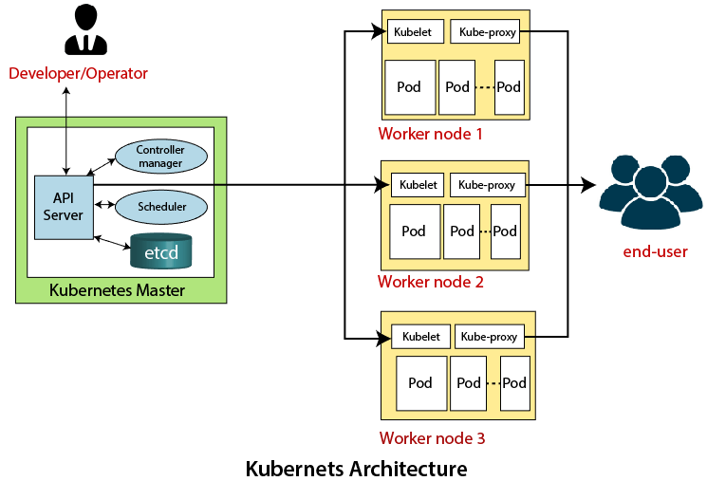
Kubernetes Architecture

Slide 6
The architecture of Kubernetes actually follows the client-server architecture. It consists of the following two main components:
Master Node (Control Plane)
Slave/worker node
Master Node or Kubernetes Control Plane
The master node in a Kubernetes architecture is used to manage the states of a cluster. It is actually an entry point for all types of administrative tasks. In the Kubernetes cluster, more than one master node is present for checking the fault tolerance.
API Server
The Kubernetes API server receives the REST commands which are sent by the user. After receiving, it validates the REST requests, process, and then executes them.
Scheduler
The scheduler in a master node schedules the tasks to the worker nodes. And, for every worker node, it is used to store the resource usage information.

Slide 7
Controller Manager
The Controller manager is also known as a controller. It is a daemon that executes in the non-terminating control loops. The controllers in a master node perform a task and manage the state of the cluster.
ETCD
It is an open-source, simple, distributed key-value storage which is used to store the cluster data. It is a part of a master node which is written in a GO programming language.
Worker/Slave node
The Worker node in a Kubernetes is also known as minions. A worker node is a physical machine that executes the applications using pods. It contains all the essential services which allow a user to assign the resources to the scheduled containers.
POD:
A Pod is a collection of containers and its storage inside a node of a Kubernetes
cluster. It is possible to create a pod with multiple containers inside it. For example, keeping a database container and data container in the same
pod.

Slide 8
Basic Kubernetes Commands
Get version-related information
kubectl version
Get configuration details
kubectl config view
Create deployment
kubectl create deployment <deploy name> –image=<image name>
Delete deployment
kubectl delete deploy <deploy name>

Slide 9
List all current pods
kubectl get pods
Describe pod names
kubectl describe pod<name>
To scale the replication counter, counting the number of instances
kubectl scale -replicas=<count>rc<name>
Stopping all pods in <n>
kubectl drain<n>– delete-local-data–force–ignore-daemonset

Slide 10
Lists Services
kubectl get svc
Shows a service name
kubectl describe svc<name>
Deletes a pod
kubectl delete pod<name>
Executes the command on service by choosing a container
kubectl exec<service> <commands>[-c< $container>]

Slide 11
Gets logs from the service for a container
kubectl logs -f<name>>[-c< $container>]
Show metrics for a pod
kubectl top pod
Launching a pod with a name and image
kubectl run<name> -image=<image-name>

Slide 12
Thank you

